Slide 1


SOLE 101 : USING QUESTIONS TO DRIVE LEARNING
Jeff McClellan, StartSOLE
@jeffmcclellan9
@STARTSOLE
Brenda Gift
bgift@esclakeeriewest.org

Slide 2
Desired Outcomes
You will be actively engaged
Connect your training to Gifted
You will learn a bit about us
You will learn about SOLE
You will leave equipped with the tools to use SOLE in your environment
You will have time to plan the implementation of SOLE with role-like peers

Slide 3
Tentative Agenda
9 - 10:00 | Introductions & Housekeeping
10 - 11:00 | What is the Future of Learning?
11 - 12:00 | Do a SOLE
12 - 12:30 | Lunch
12:30 - 1:30 | Tools for SOLE in your classroom
1:30 - 2:30 | Plan to do 3 SOLEs in your classroom
2:30 - 3:00 | Wrap up and adjourn
Notes:
This can be customized as appropriate.

Slide 4
Housekeeping
Restrooms
Cell Phones
Snacks
Lunch
Parking Lot

Slide 5
Introductions
Notes:
Use this section to introduce yourself to the group. Connect your experience to the history of STARTSOLE. I have left my background slides in here as placeholders but you should replace these with slides that represent you. Also make sure to take time to allow each member of the training to introduce themselves. This should be very brief but they should be encouraged to give their name, grade, subject, and school that they work at.

Slide 6


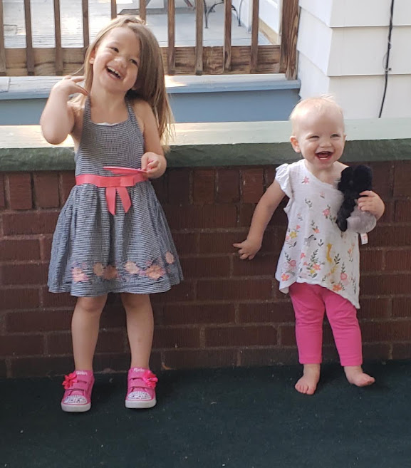
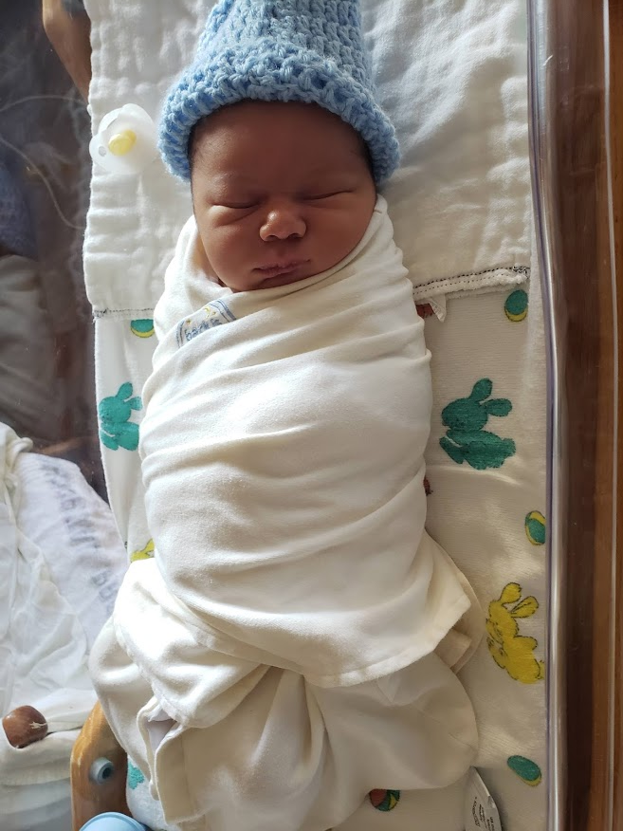

Slide 7



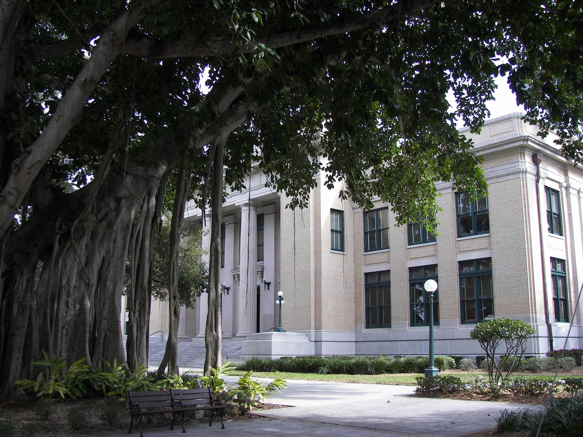



Slide 8


Slide 9


Slide 10

Notes:
I begin with an introduction to my family… customize this as appropriate for you!

Slide 11


Slide 12


Slide 13
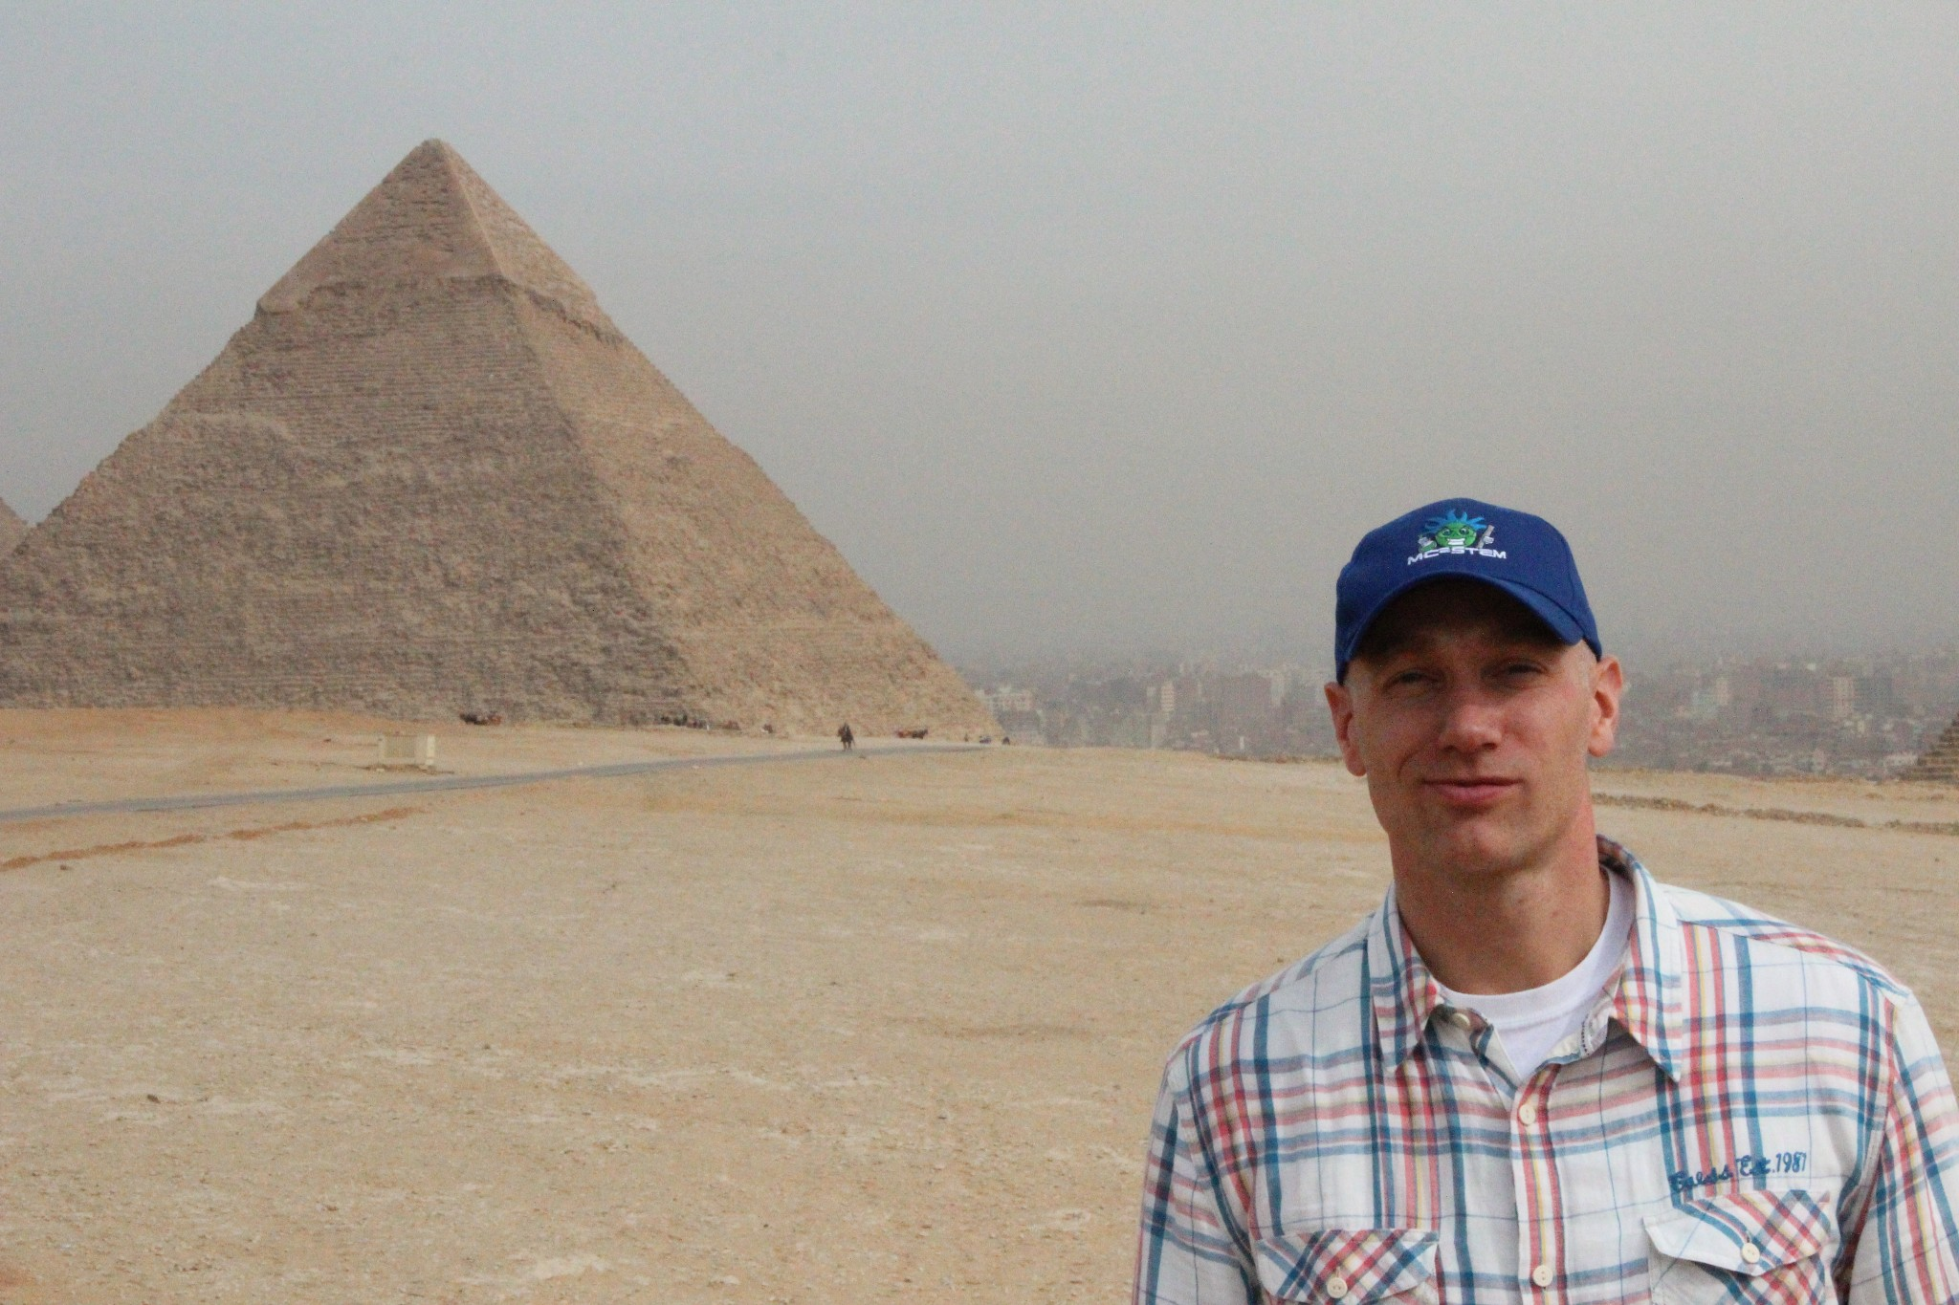
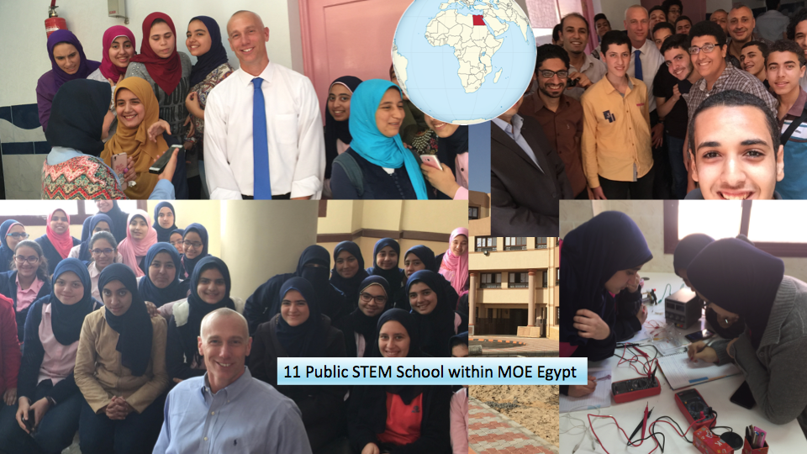
Notes:
I also worked on a project setting up a network of STEM schools in Egypt. As we were looking to engineer a system for StartSOLE, we looked to engineering for inspiration. Engineers have known for centuries that an equilateral triangle is the strongest two dimensional structure. Actually an equilateral triangle resists distortion based destruction with the most efficiency of any two dimensional structure. I use this to make a metaphorical connection to students who won’t break under the pressures of the 21st century.

Slide 14
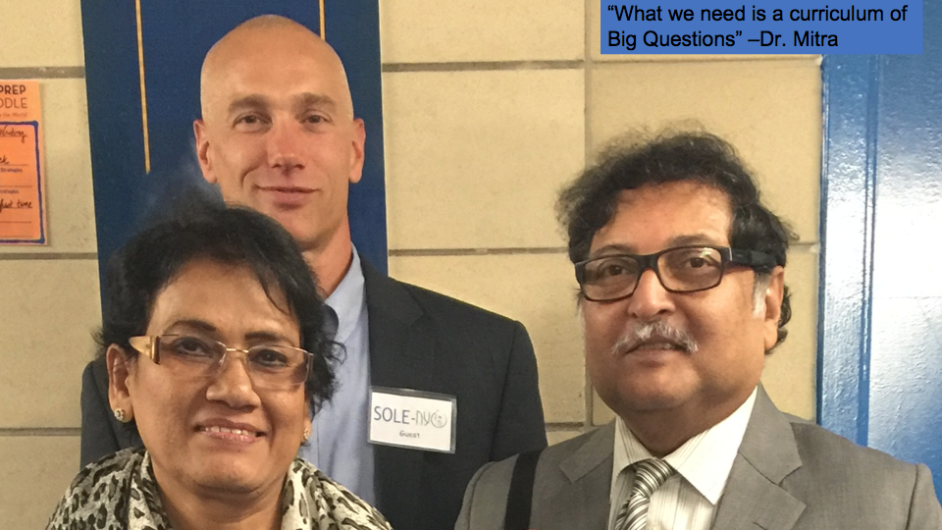

Slide 15
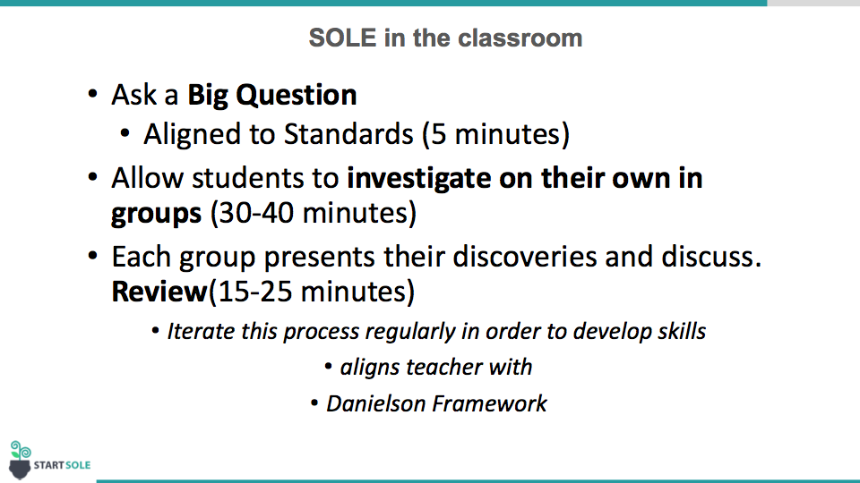

Slide 16
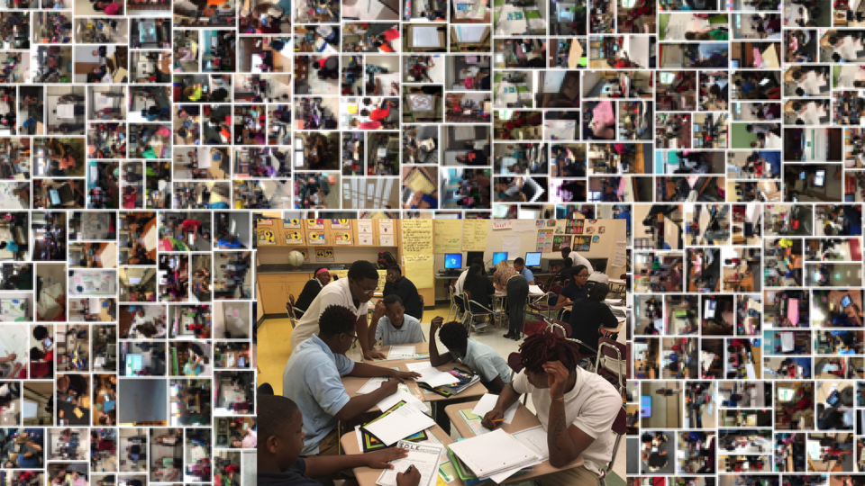
Notes:
Jeff has taken what he learned about transforming classrooms and created STARTSOLE.
STARTSOLE supports the implementation of the SOLE strategy in any classroom anywhere.

Slide 17
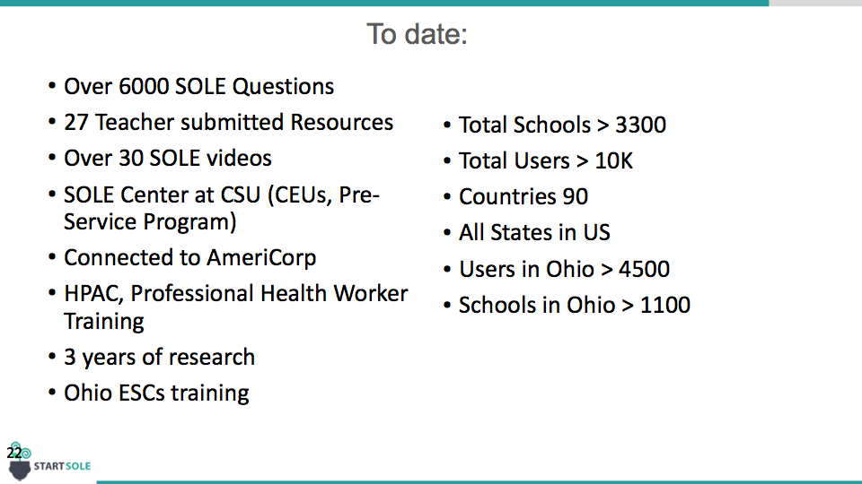
Notes:
Jeff has taken what he learned about transforming classrooms and created STARTSOLE.
STARTSOLE supports the implementation of the SOLE strategy in any classroom anywhere.

Slide 18
Questions ?

Slide 19
What is the future of learning?
Notes:
Now we are going to watch a few excerpts from Sugata Mitra’s million dollar winning TED Talk. We are going to use an ‘around the clock’ protocol to breakdown our discussion of these clips.

Slide 20

Schedule your appointments
Meet three people in the room that you do not know and schedule appointments with each of them for later in the presentation. Each appointment will be either round 1, 2, or 3.
Take 3-5 Minutes to do this

Slide 21
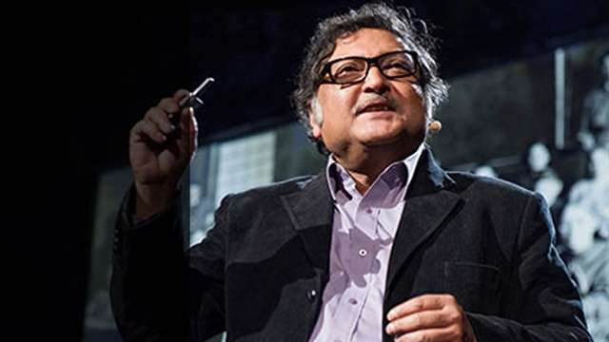
Sugata Mitra: Build a School in the Cloud
Using the
“around the clock” protocol we will unpack three components of Sugata Mitra’s
Ted Talk

Slide 22
Part 1 (0-4)
Appointment 1
Find the person that you have scheduled for Appointment 1.
Discuss the video clip (5 minutes)
Whole Group discussion (10 minutes)

Slide 23
Part 2 (12:37-15:06)
Appointment 2
Find the person that you have scheduled for Appointment 2.
Discuss the video clip (5 minutes)
Whole Group discussion (10 minutes)

Slide 24
Part 3 (16:06-19:29)
Appointment 3
Find the person that you have scheduled for Appointment 3
Discuss the video clip (5 minutes)
Whole Group discussion (10 minutes)

Slide 25
DO a SOLE

Slide 26

How to do a SOLE
Notes:
Before you actually do a SOLE, we recommend watching this ‘How to SOLE’ video with participants.

Slide 27
SOLE in the classroom
Ask a Big Question
Aligned to standards (5 minutes)
Allow students to Investigate
Students work on their own in groups (30-40 minutes)
Review their discoveries and discuss.
Each group takes about 2 minutes (15-25 minutes total)
Notes:
Remind participants that this work is aligned to the Charlotte Danielson framework for lesson planning and iterating on this process regularly helps develop student skills

Slide 28
What is the future of teaching?
Get into groups of 4-5
Research and prepare a 1 minute presentation (30 Minutes)
Be creative
Cite at least 2 sources
Check out what other groups are doing while you are researching
Review and Discussion (30 Minutes)
Notes:
Use these general guidelines to facilitate a SOLE with the group of participants. This could also be facilitated using the StartSOLE app.

Slide 29
SOLE Process Debrief
Each SOLE takes one class period
Works with any subject area
Teachers iterate the SOLE process once a week or once every other week for maximum impact
Process is aligned to OTES
Resources aligned to Ohio State Standards
How could you see SOLE being used in your environment?
What opportunities do you see?
What are some Challenges you anticipate?
Notes:
Here are some key points to summarize in your review of the SOLE process.

Slide 30
Getting familiar with the tools

Slide 31
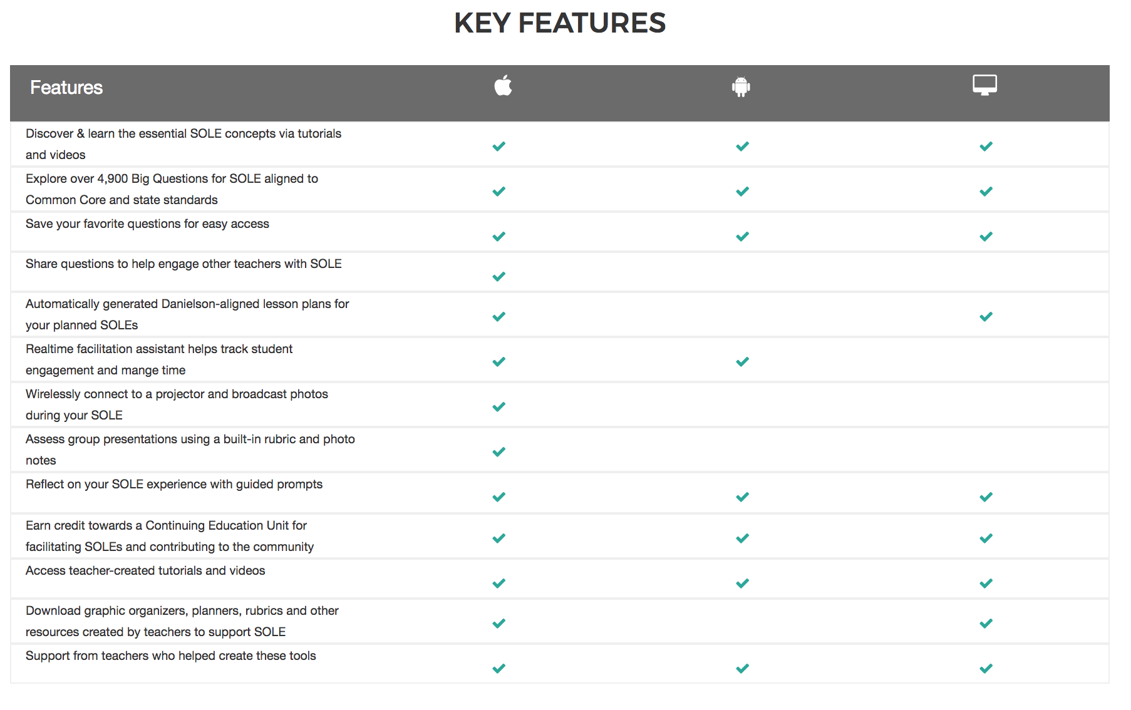
Tools Available – By Platform
Lesson Summary
SOLE Approval

Slide 32
Free tools for support
On the Web: www.startsole.org
IOS/Android devices: StartSOLE
(Time to set up accounts and review tools)
Notes:
Presenter beings up website in screen and walks participants through the following processes:
Account creation
Question explorations
Lesson Plan creation
Resource exploration
App usage.

Slide 33
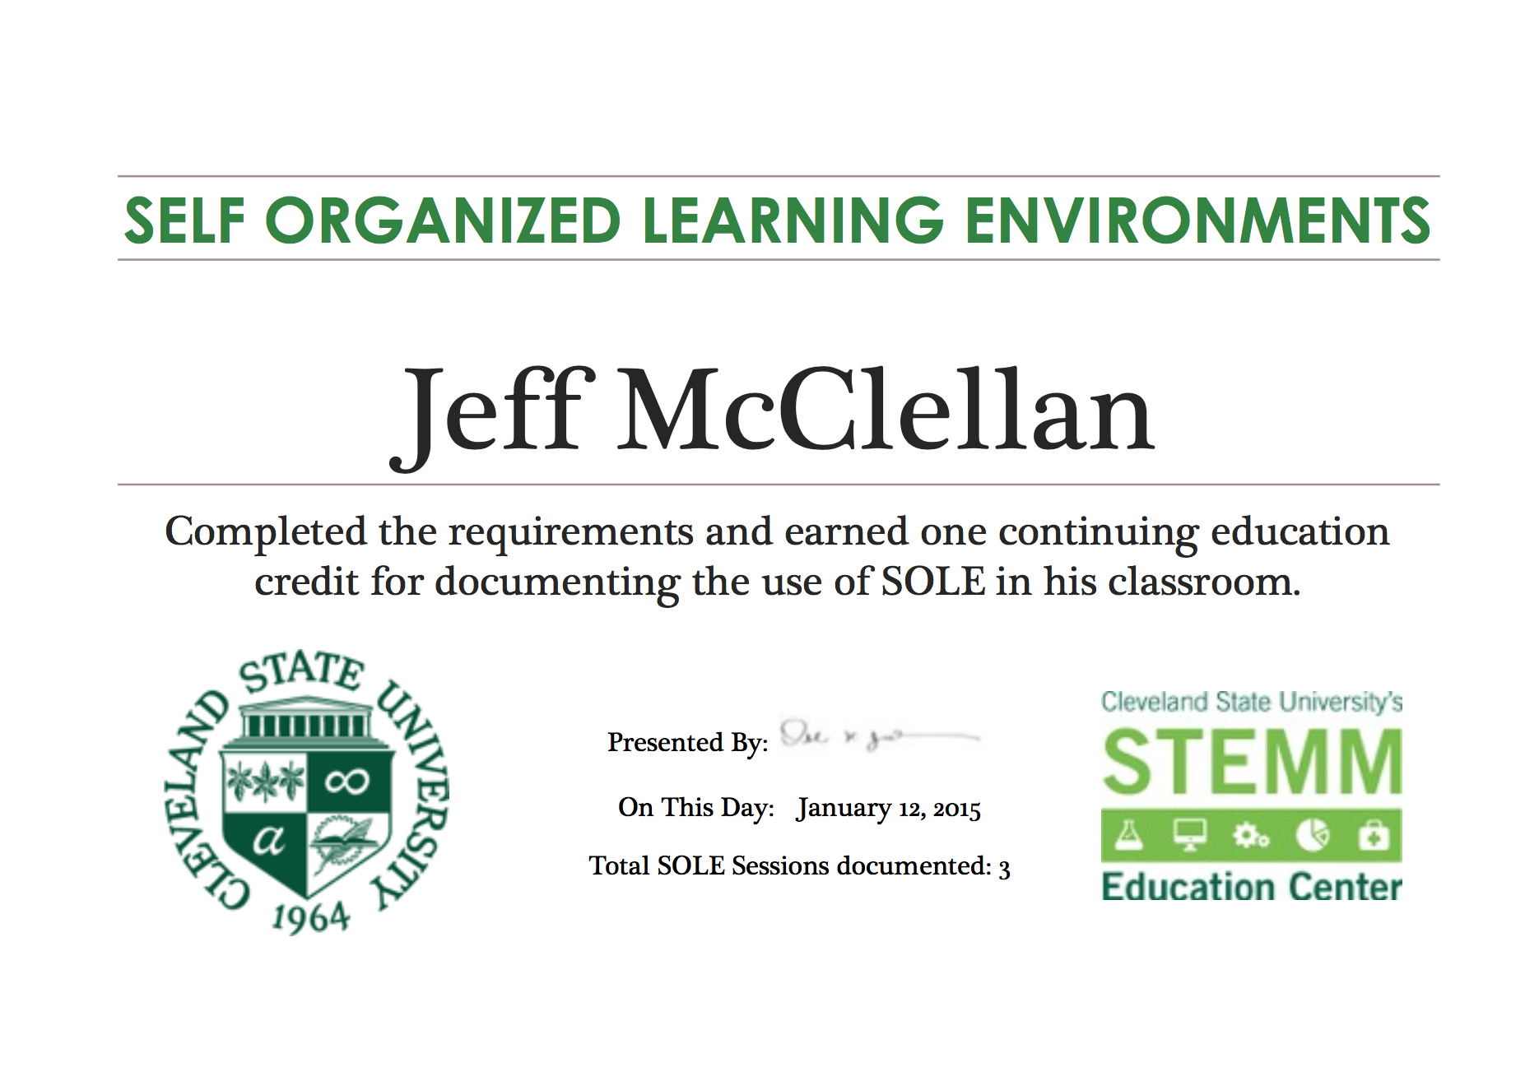
Continuous Education Support

Slide 34
Grade level group work
Notes:
Break room into grade level groups of 3-5 per group. You will need to decide how large or small the grade band can be based on the grade breakdown of the room. Once the groups are set move around the room and support the groups individually.

Slide 35
Grade Level Groups
What will you need to effectively implement SOLE with your students?
Identify 3 SOLE questions that you plan to use with your students
Talk about how you will implement them into your schedule
Notes:
Break room into grade level groups of 3-5 per group. You will need to decide how large or small the grade band can be based on the grade breakdown of the room. Once the groups are set move around the room and support the groups individually.

Slide 36
Summary and Plus/Delta

Slide 37

Contact:
jeff@startsole.org
bgift@esclakeeriewest.org
twitter @giftedbrenda
twitter @startsole
facebook.com/startsole
@jeffmcclellan9
Notes:
Feel free to add your contact information to this slide.

Slide 38
Impact of SOLE on Students (Weisblatt, Stiles 2017)
Curious to use SOLE
Increase ownership over their Learning
Increase academic, social and self-management skills
Capable to apply new skills in other contexts, (E.g. Common school spaces)
Capable of complex constructs (E.g. meta-cognition)
Transformed relationships to learning
Notes:
Our research has shown that SOLE has the following impact on students. The white paper attached

Slide 39
Impact of SOLE on Teachers (Weisblatt, Stiles 2017)
Introduce SOLE
Develop facilitative skills for SOLE
Transform their relationship to teaching
Adopt and employ other pedagogies

Slide 40
Critical Thinking through SOLE
We learn by making mistakes (Weekly iteration)
We are reflective problem solvers who consider various points of view (presentations)
We collaboratively solve problems in both conventional and innovative ways (self organized)
We explore real-world issues and solve authentic problems using digital tools and resources (web based research)
Notes:
These are additional slides explaining how SOLE supports the 4 C’s: Critical Thinking, Collaboration, Communication, and Creativity

Slide 41
Collaboration through SOLE
We share ideas, questions, and possible solutions to address perceived problems.(Self organized, Presentations)
We solve problems more efficiently when we work with others and share responsibility to achieve a common goal (Self organized, weekly implantation)
Work effectively and respectfully with diverse groups. (Weekly implementation)
Value other team members’ contributions. (SOLE process)
Use digital tools/resources to collaborate in responsible respectful ways. (Web based research, Self Organized Groups)

Slide 42
Communication through SOLE
We practice strong listening skills and questioning ability (SOLE Questions, participation in presentations)
We value the ideas of diverse groups (Self organized, group presentations)
We decipher meaning through effective listening (Weekly implementation, student presentations, SOLE research)
We use communication to inform, instruct, motivate, and persuade (SOLE group process, presentations)
We use digital tools and resources to creatively communicate in responsible and respectful ways (Use of technology for presentations)

Slide 43
Creativity through SOLE
We view failure as an opportunity to learn (SOLE iterations allows mastery of skills)
We promote a culture of risk-taking (SOLE iteration)
We use creative ideas to make meaningful contributions to society (SOLE leads to kids asking more questions and looking at challenges differently)
We contribute to innovation by acting on creative ideas (SOLE group process, presentations, leads to questioning behavior)
We use digital tools and resources to creatively show what we know (Use of technology for presentations)

